Slide 1
Space is Full
By Chris R. Gilly

Slide 2

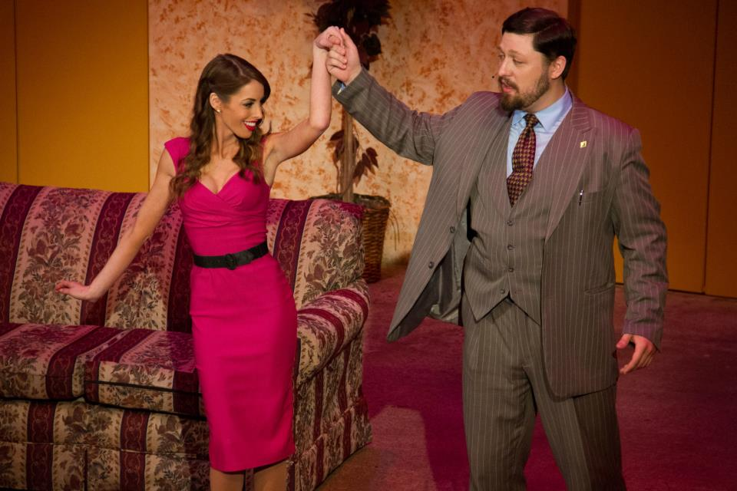
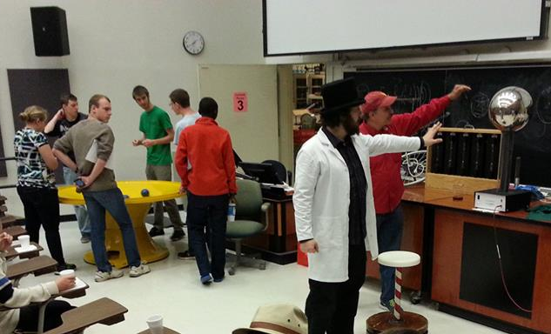

My name is Chris Gilly!
(Chris R. Gilly in publication)

Slide 3
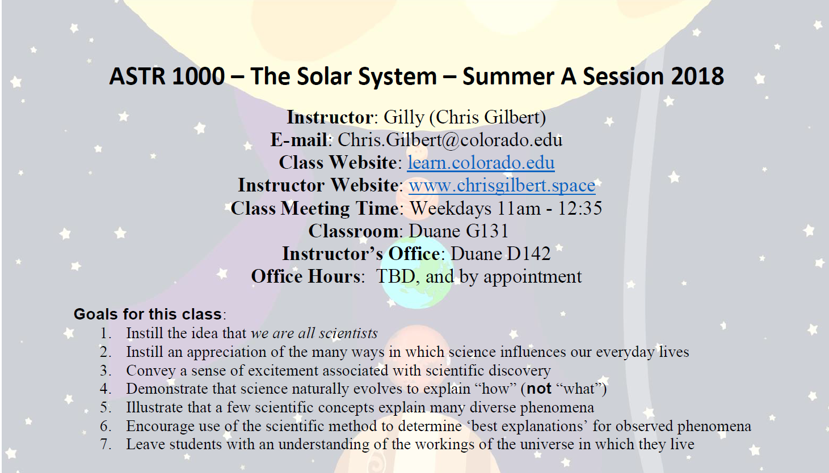
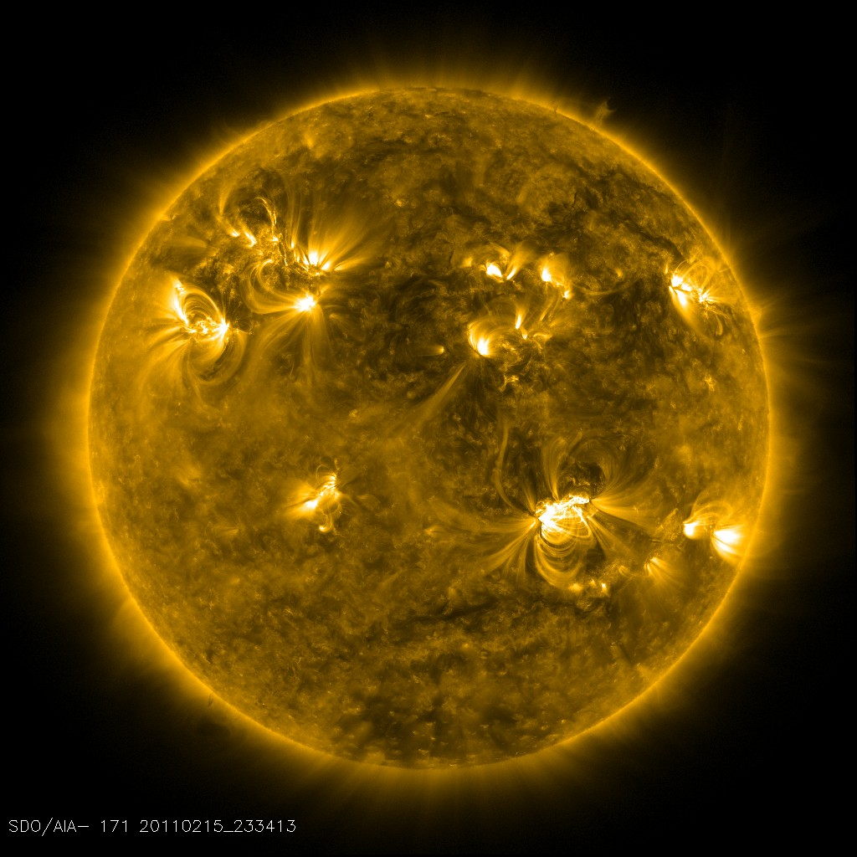



Stuff I’m Doing:
Graduate Research Assistant/ PhD Candidate
Graduate Admissions Committee
Planetarium Series Coordinator
Boulder Jr Astronauts
Summer Instructor
Check out my website: www.gilly.space

Slide 4
Space is mostly empty
…is a lie. Forget it. False.

Slide 5
Outline
Space Is Empty is a Lie
Less stuff than earth, but not empty
Zoom out, handful also has to zoom out
Sphere around earth, inside and out, outside has 10^^inf more stuff
Plasma Environment of Solar System
Solar wind and Heliopause
Magnetospheres and Aurorae
Galaxy as ocean, Heliotail
What is the most empty place?
Between Galaxies?
Graduate Admissions
Rubric
Statistics – Not just about qualifications
Personal statements – my impressions
Research description is useless
Try to hit multiple dimensions – all eggs in one basket is bunk
Letters of Rec are less important
Only a small percentage

Slide 6
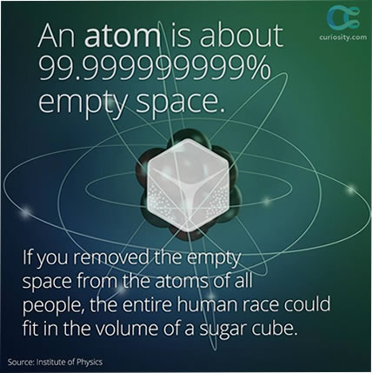
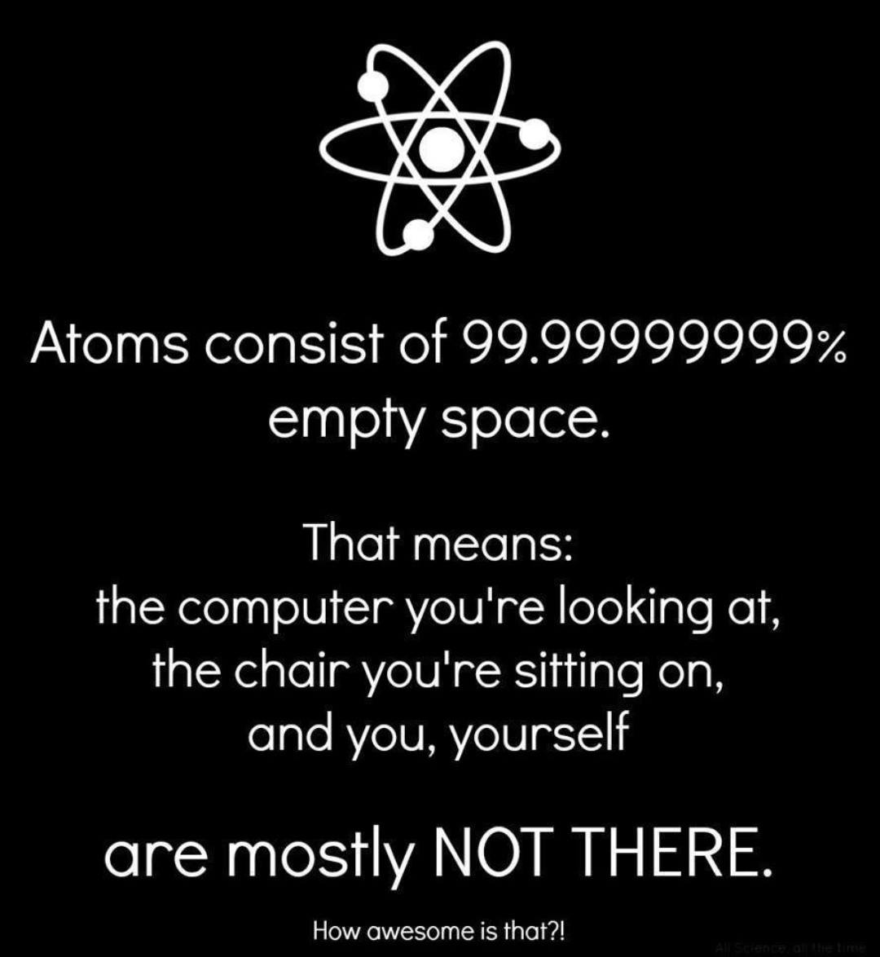

Slide 7
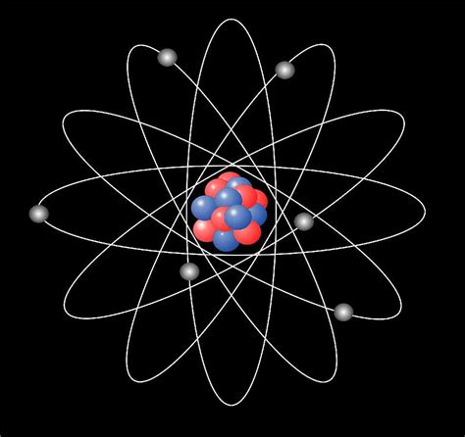
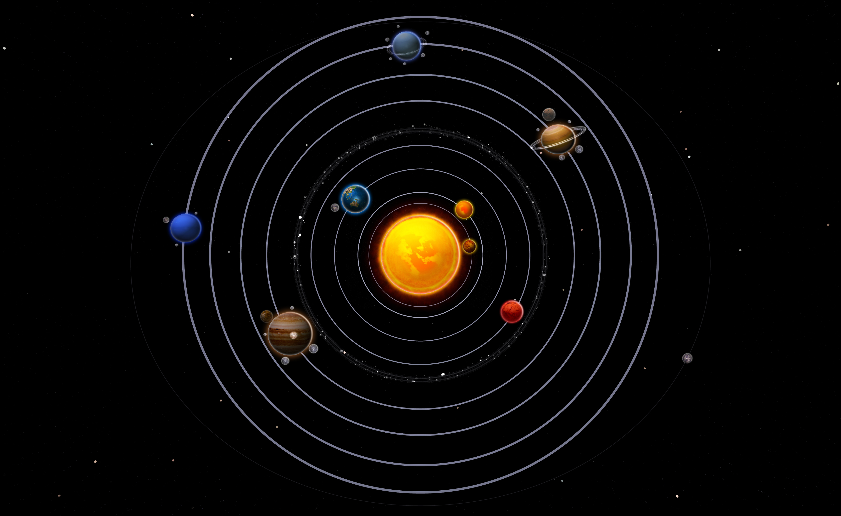
But is the same thing true about space?

Slide 8
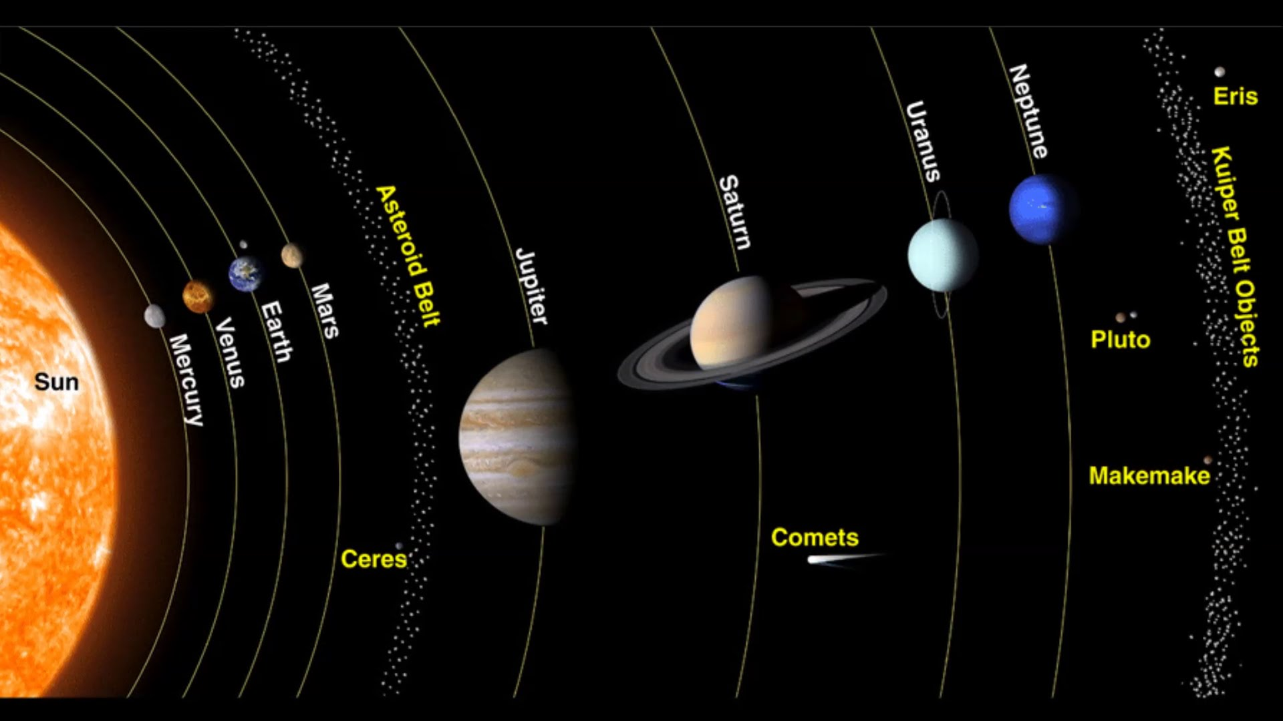

Slide 9
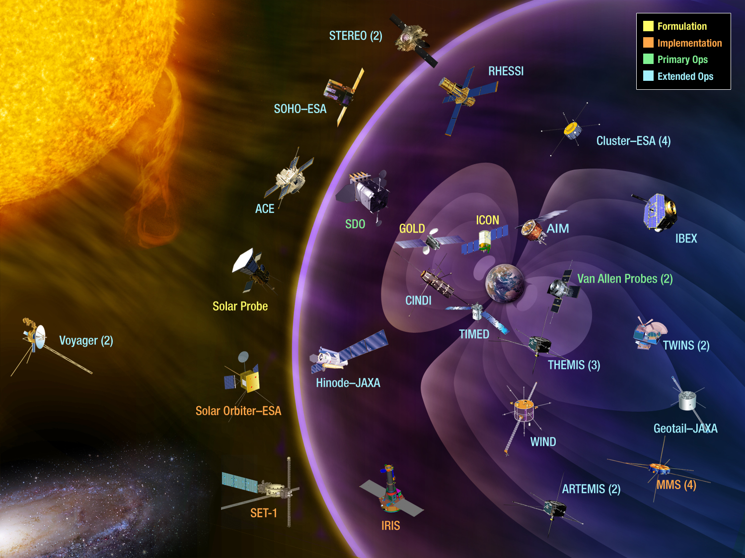

Slide 10
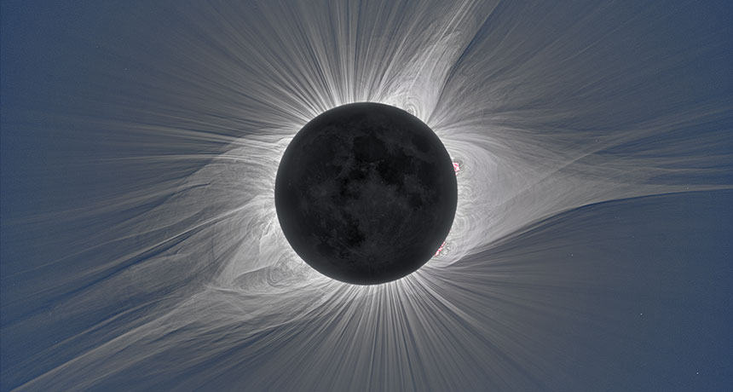

Slide 11
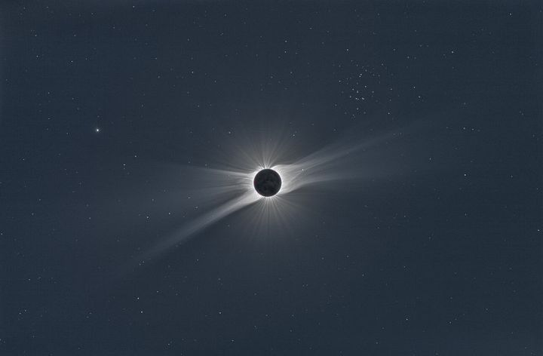

Slide 12
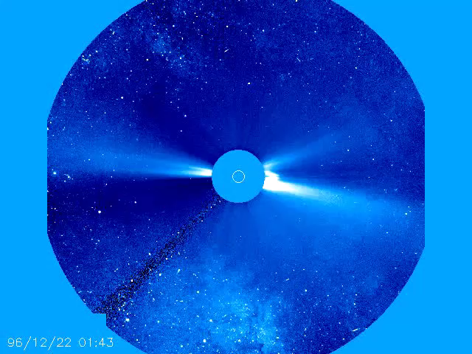
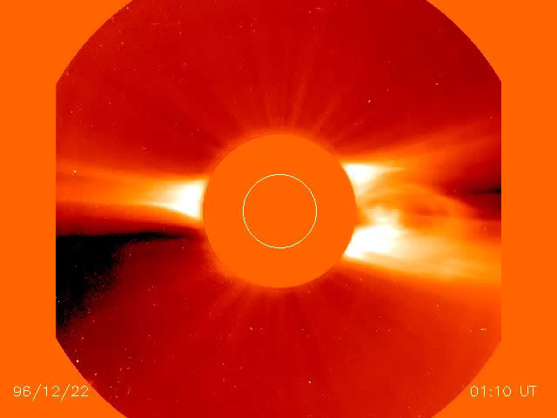
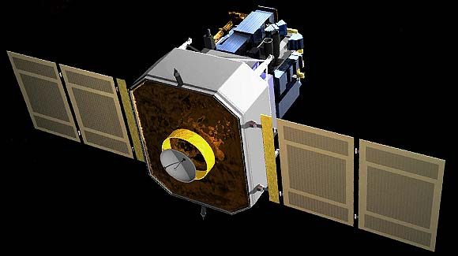
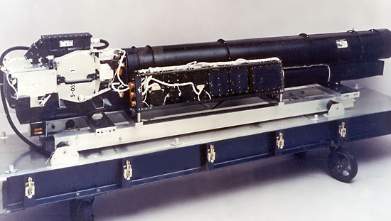

Slide 13
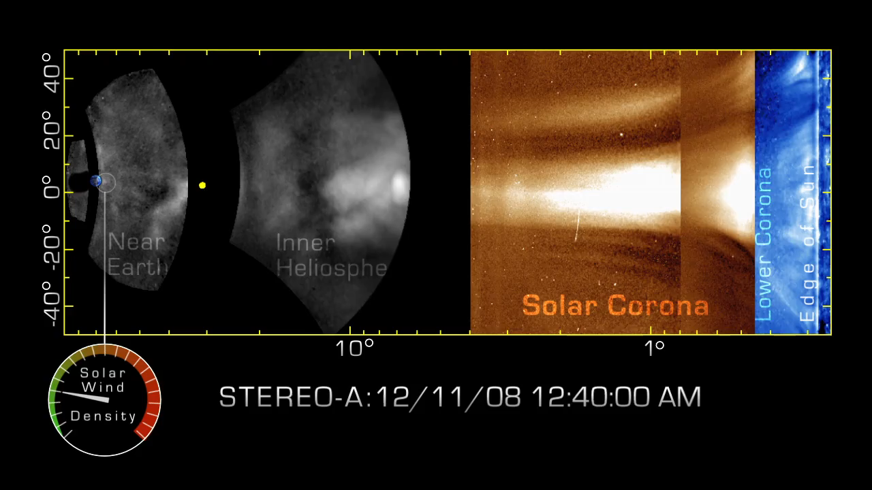

Slide 14
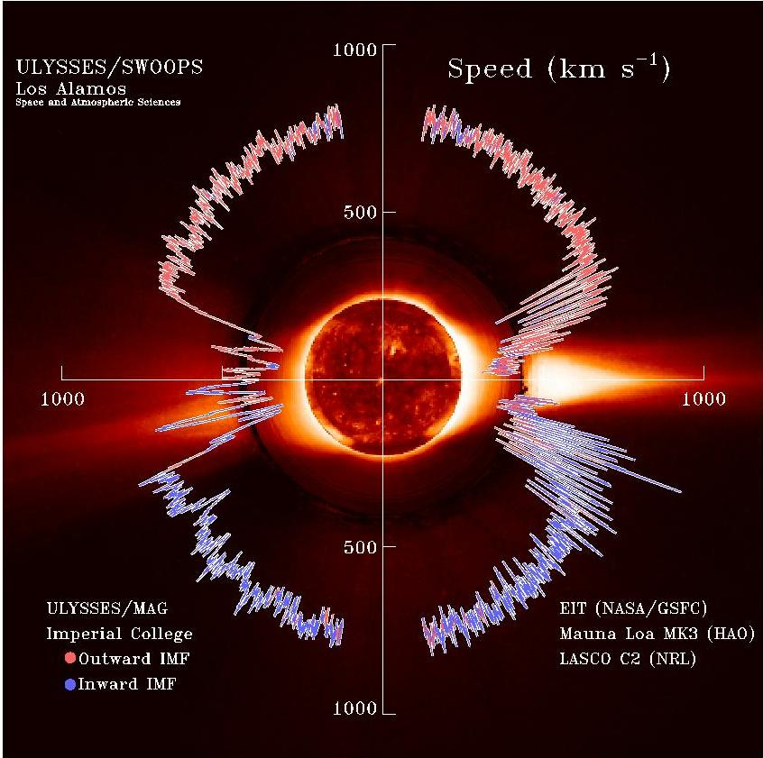
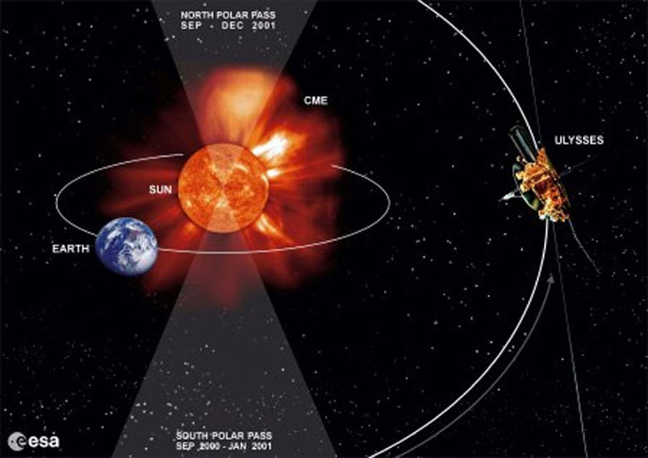
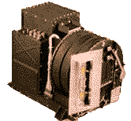
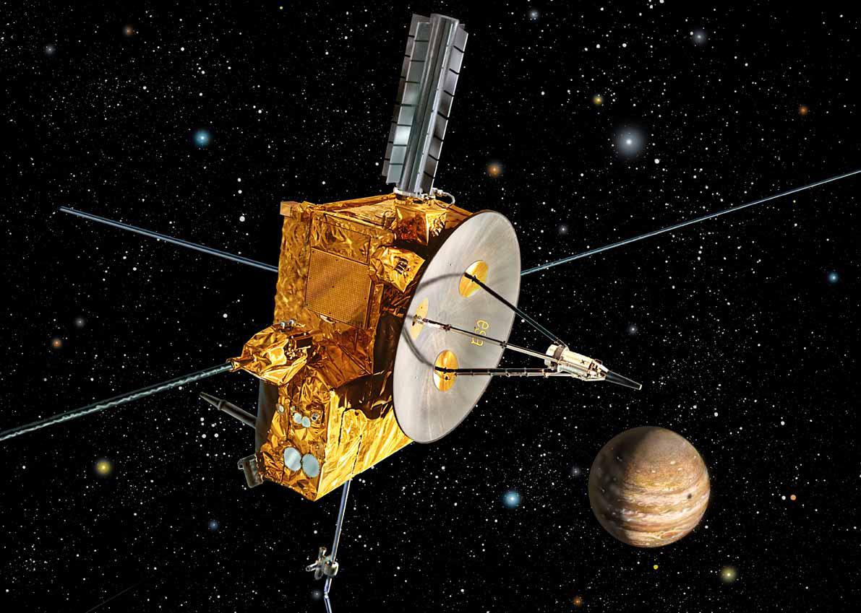

Slide 15
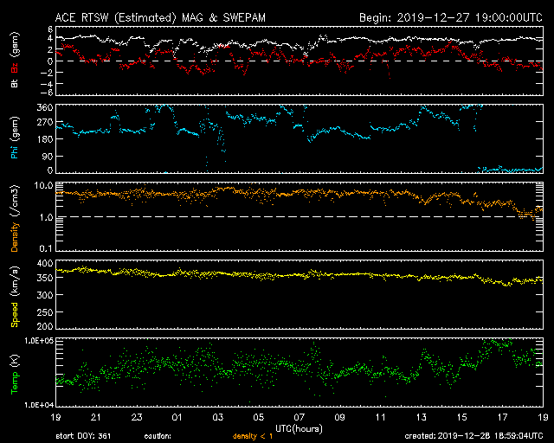
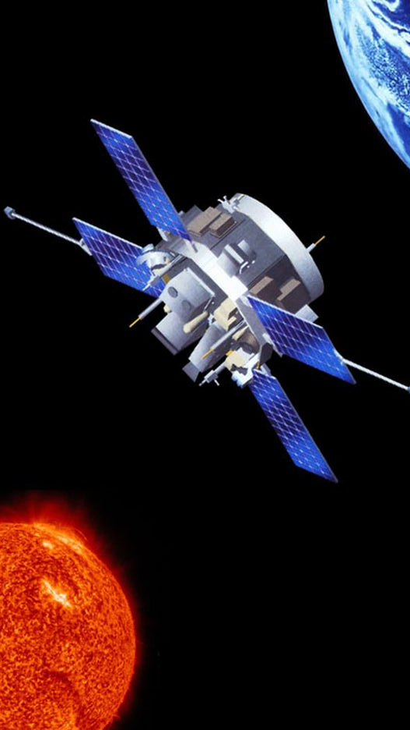

Slide 16
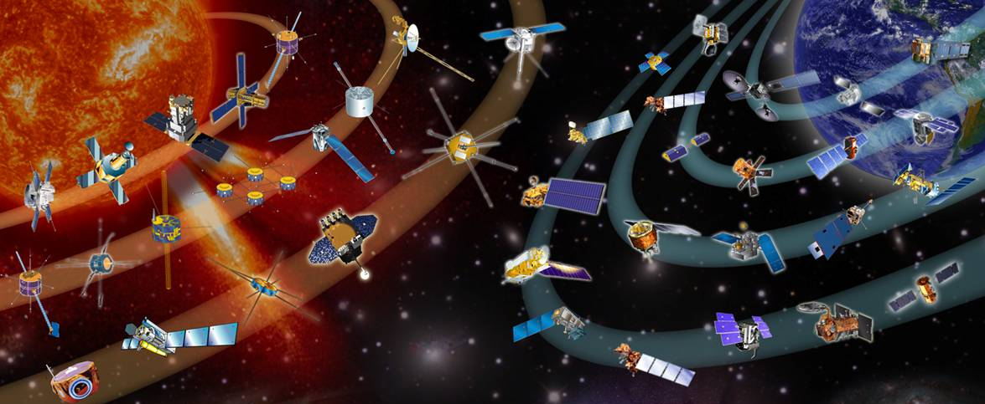
Spacecraft, Remote and In-situ

Slide 17
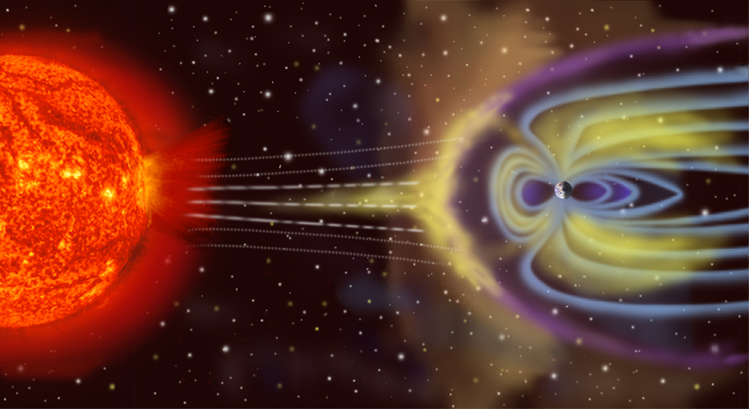

Slide 18
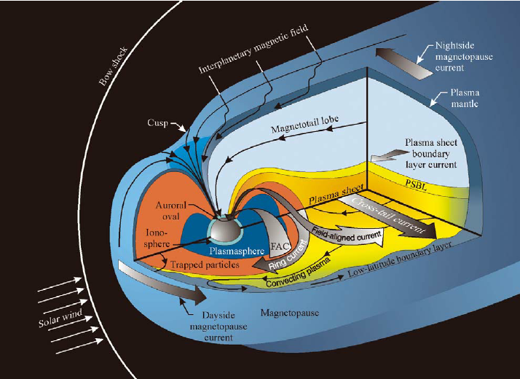

Slide 19
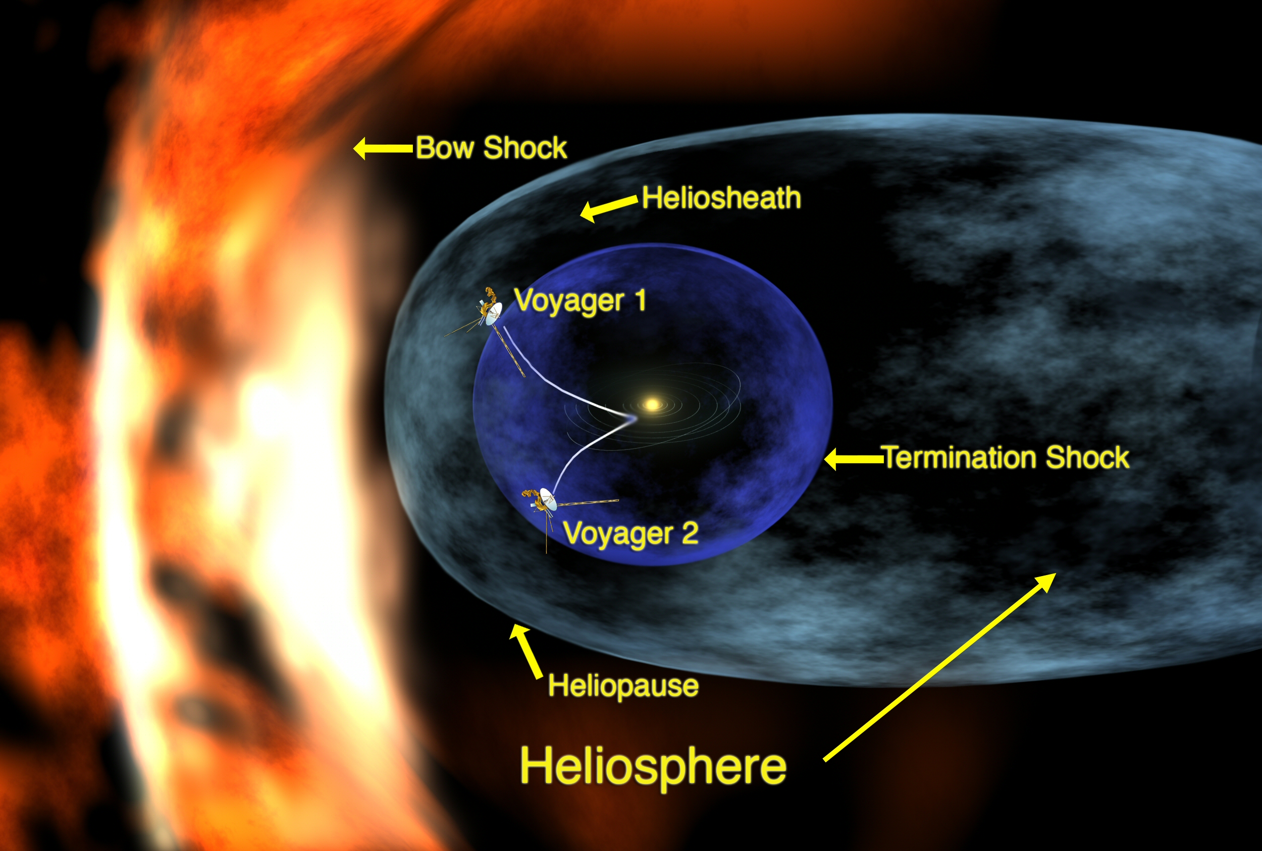

Slide 20
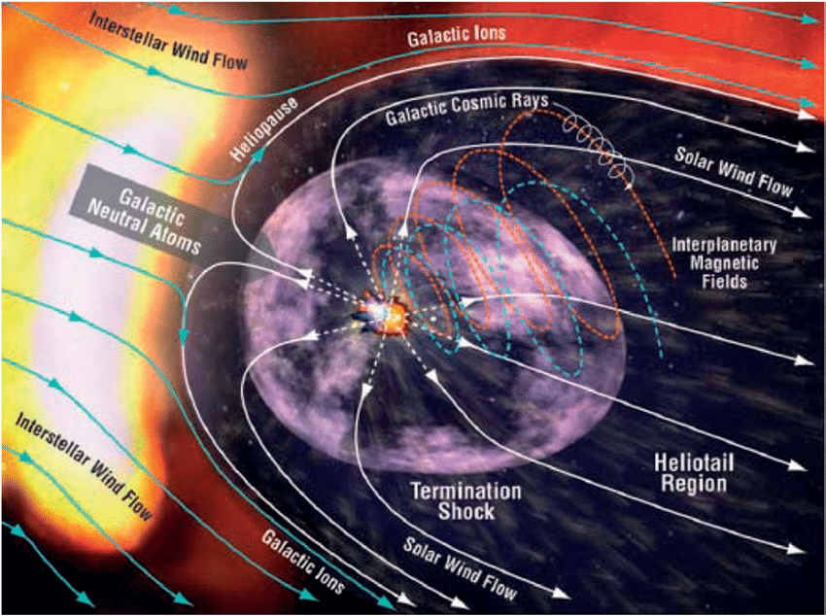

Slide 21
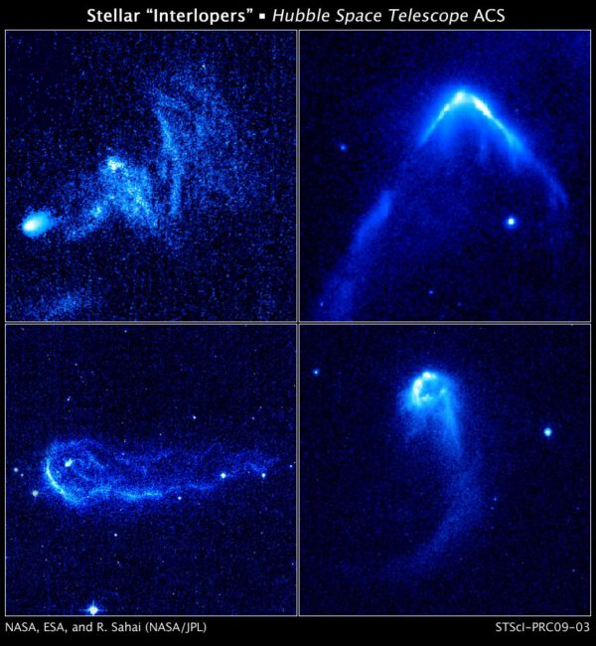
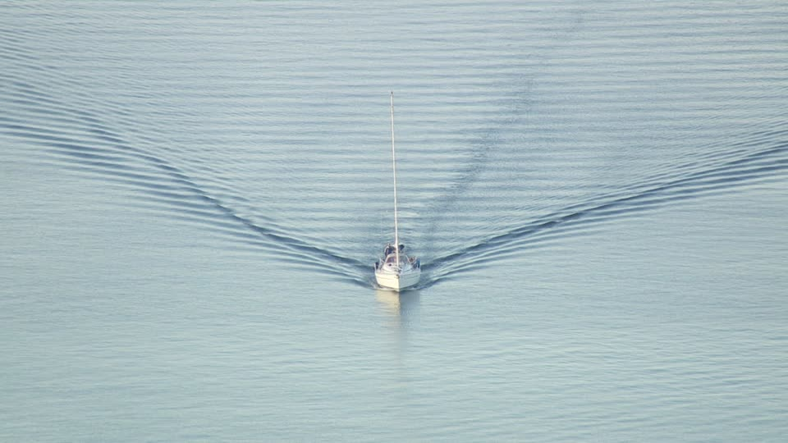
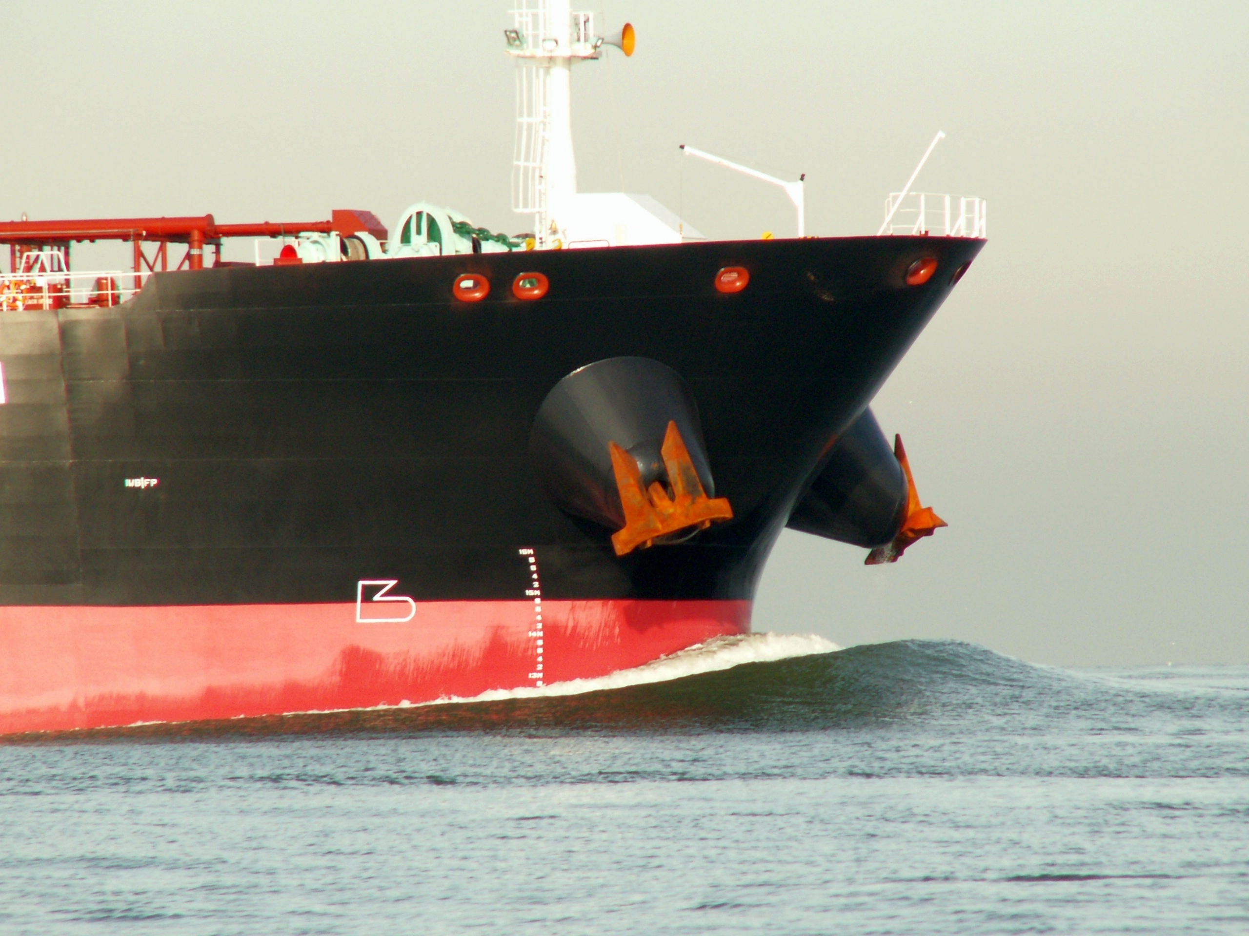
Ocean Between Stars
Four runaway stars plowing through regions of dense interstellar gas and creating bright bow waves and trailing tails of glowing gas. Image credit: NASA, ESA and R. Sahai (NASA/JPL), taken with Hubble's Advanced Camera for Surveys.

Slide 22
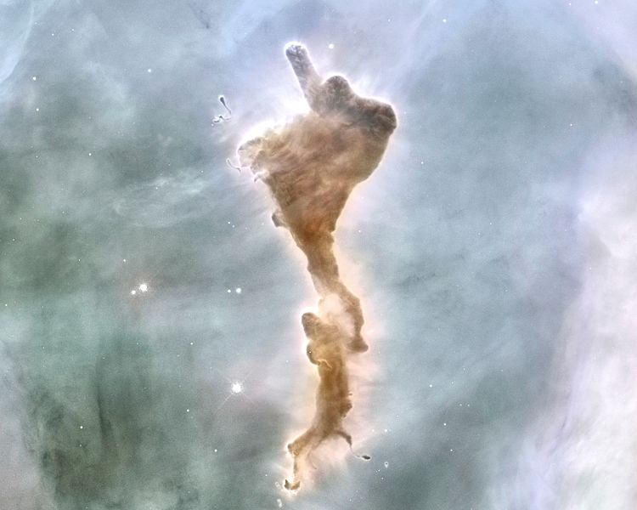
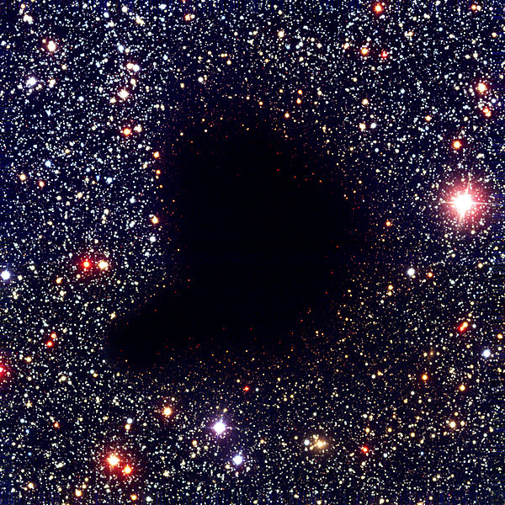

Slide 23
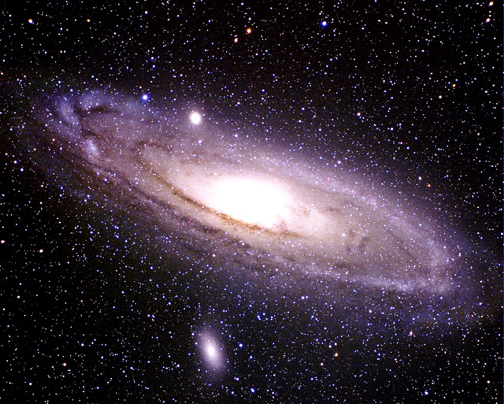
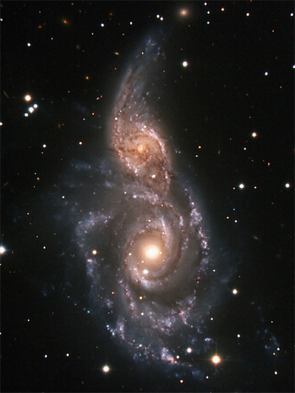

Slide 24
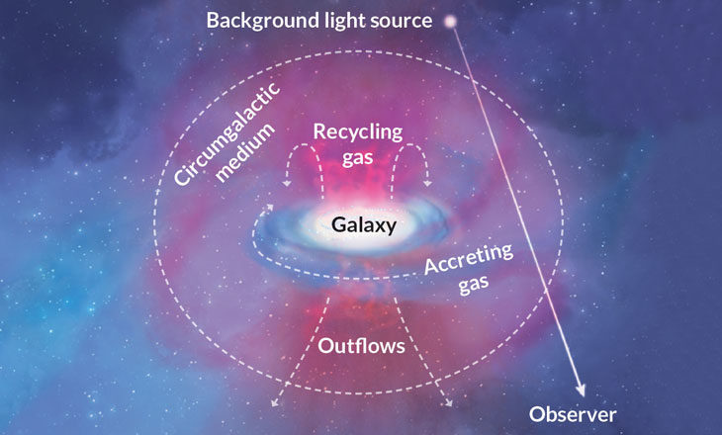

Slide 25
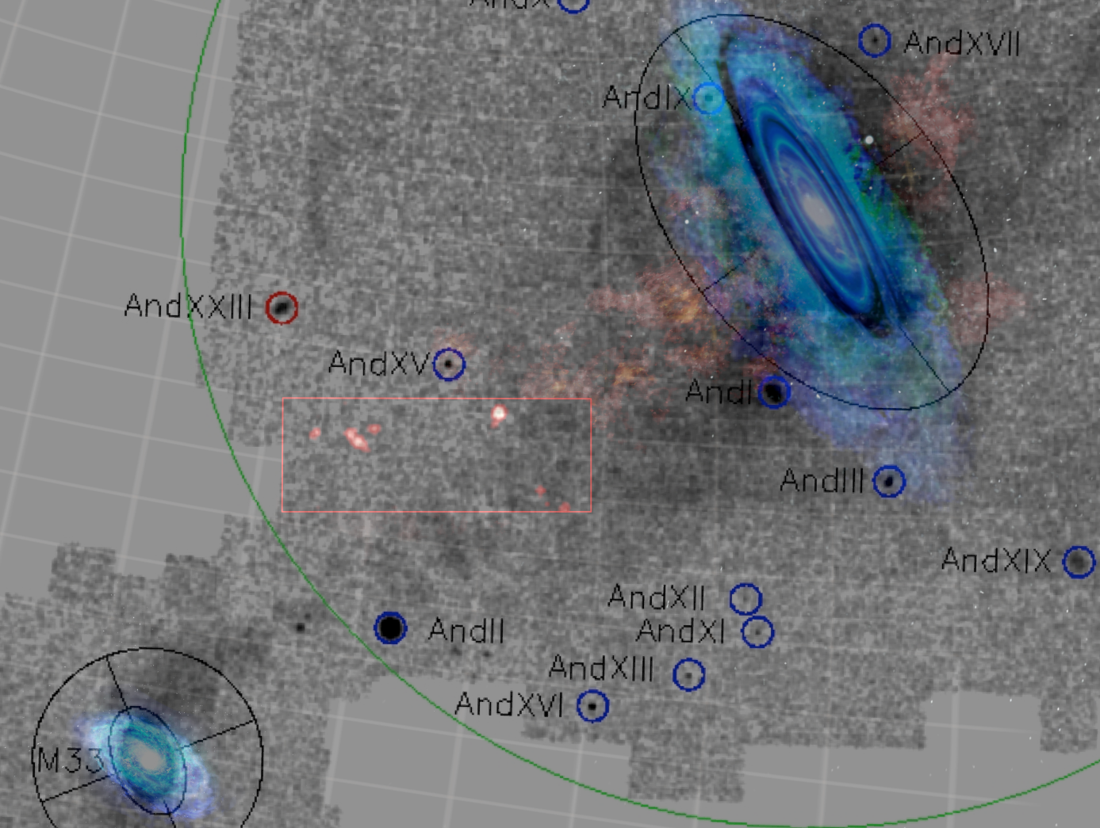

Slide 26
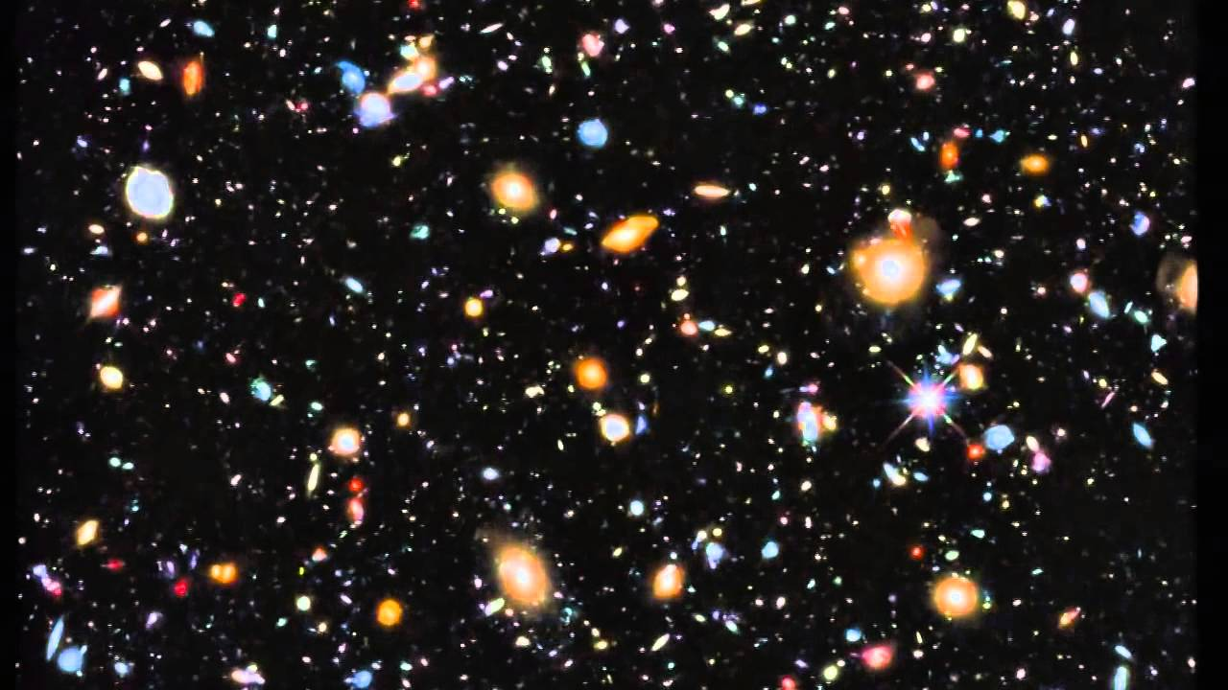

Slide 27
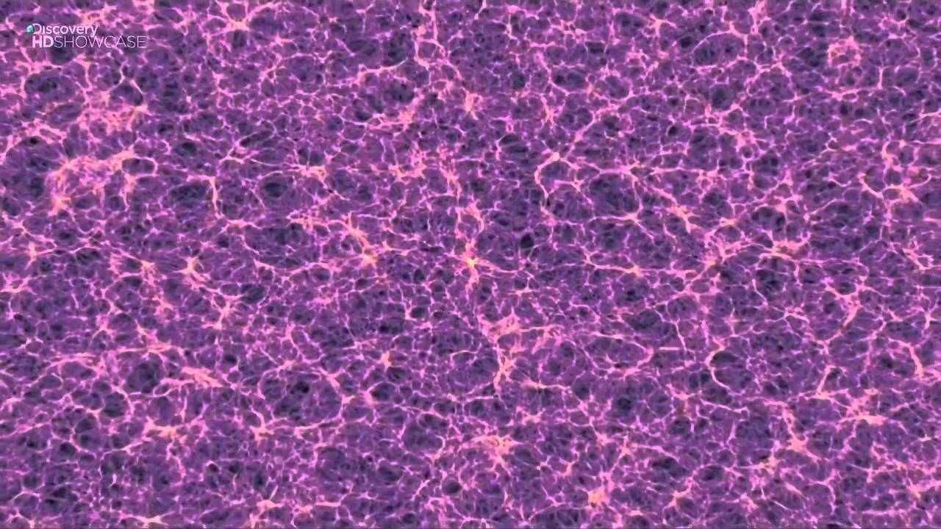
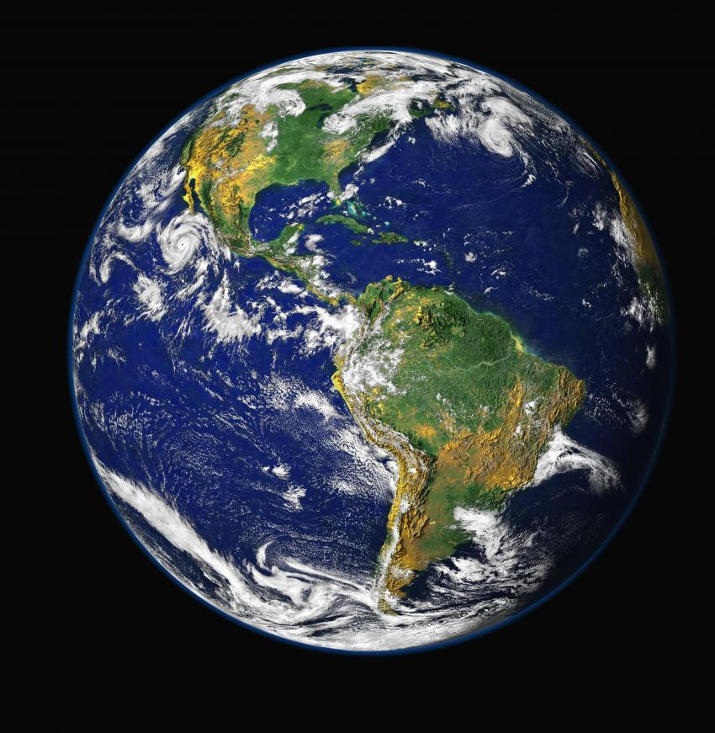

Slide 28
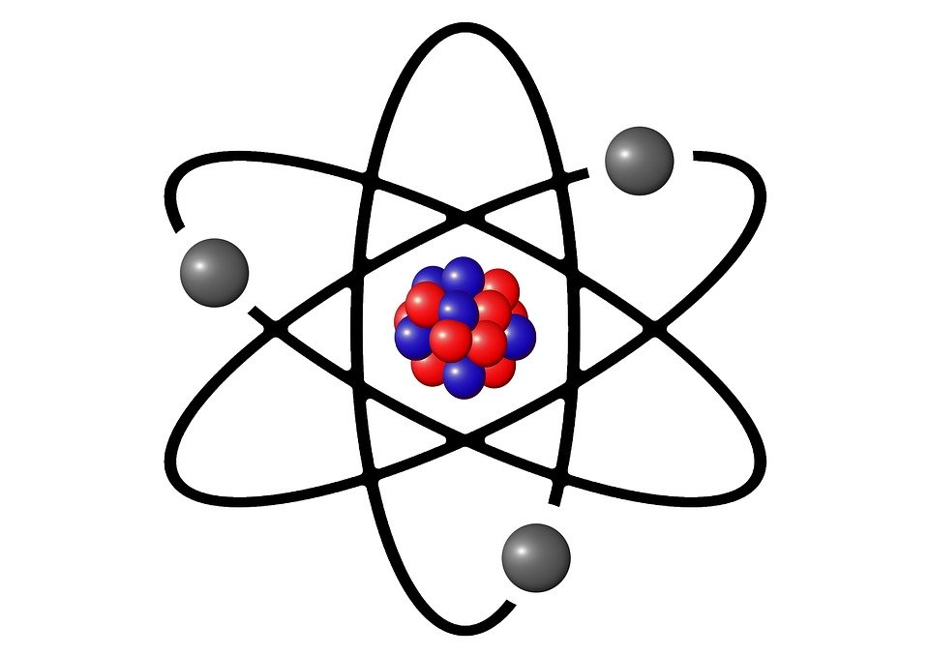
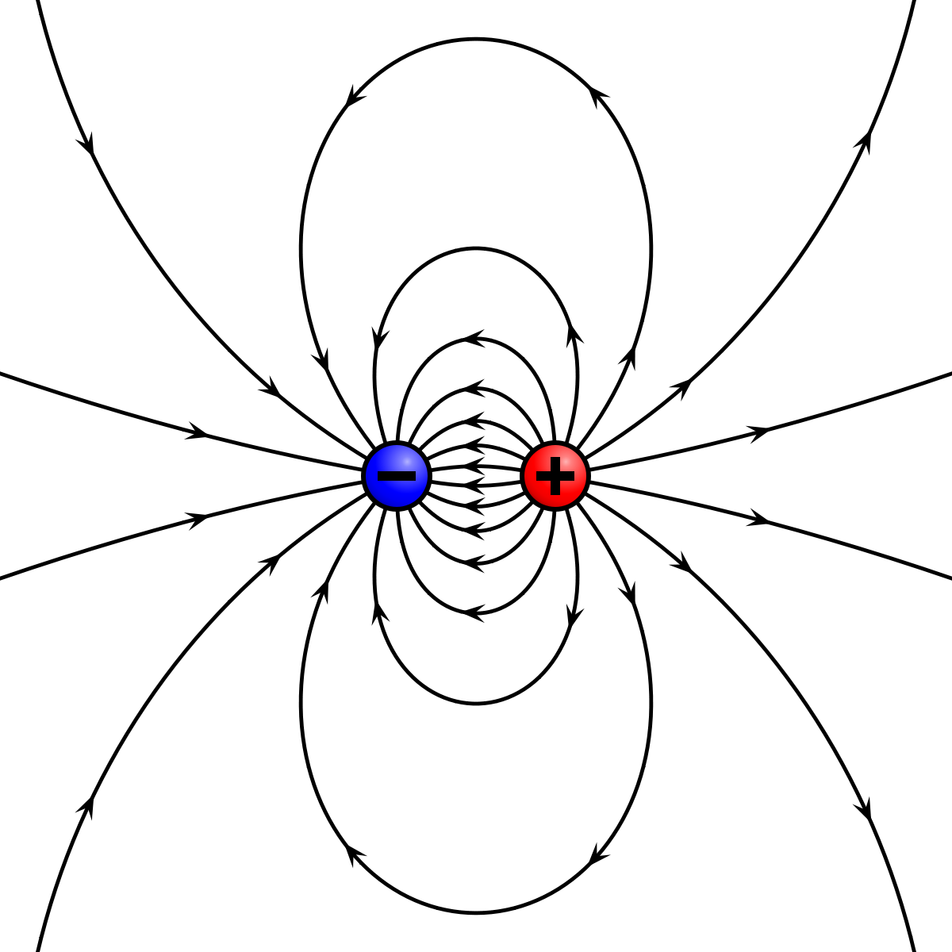
That’s enough about big stuff…what about small stuff?

Slide 29
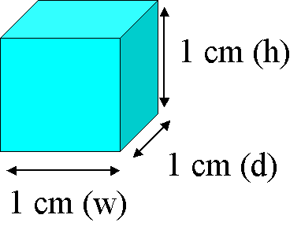
Lets imagine just a tiny cube of “nothing” deep in space

Slide 30
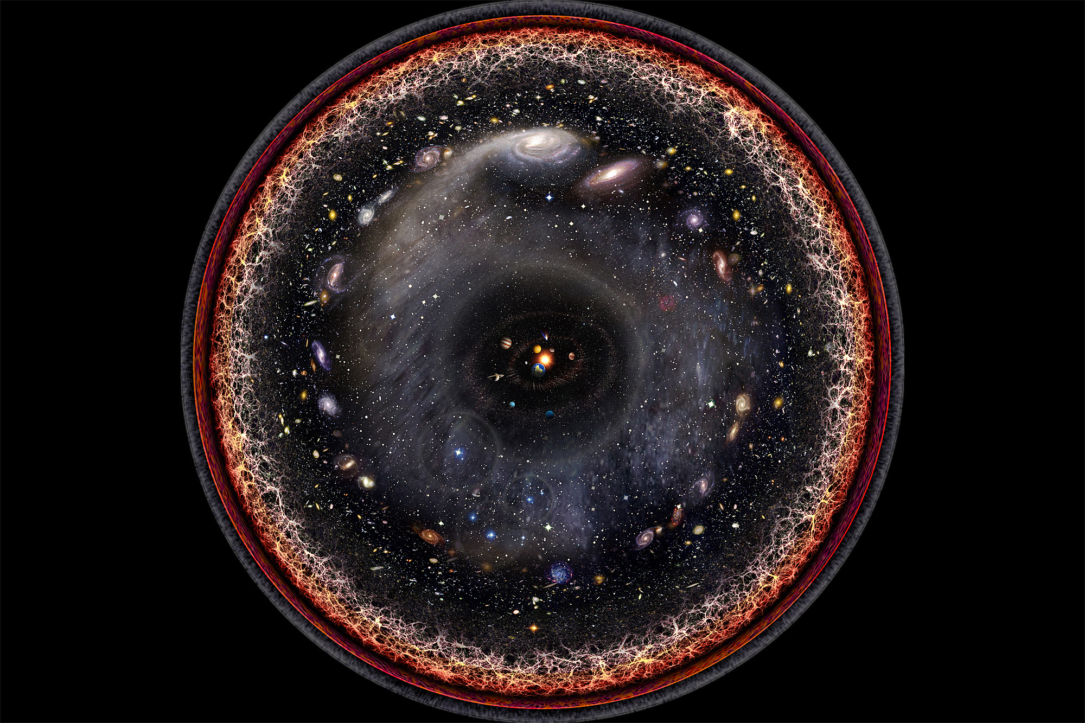
Photons

Slide 31
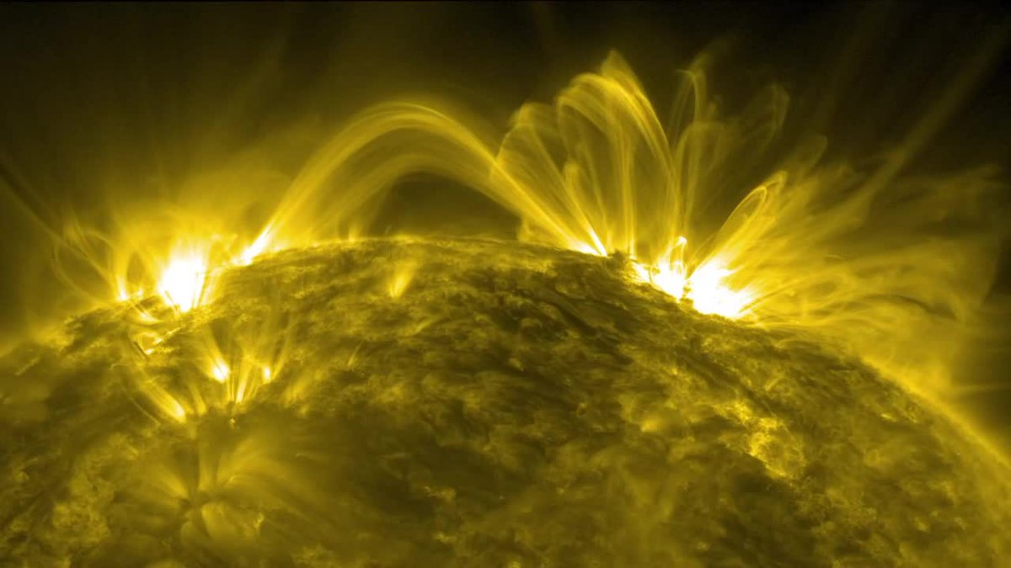
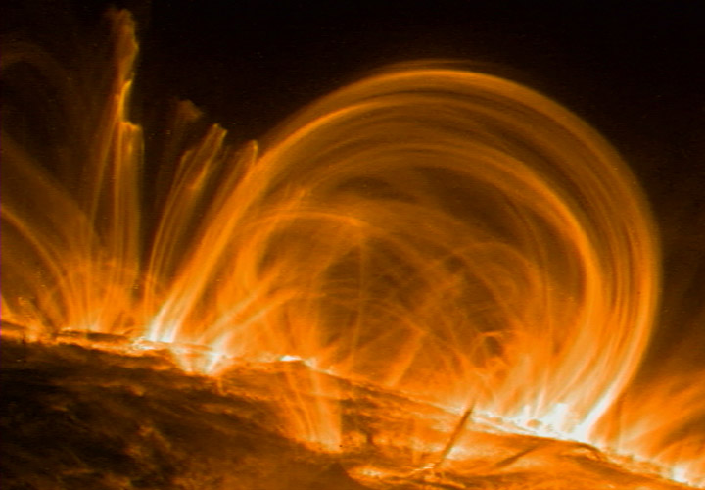
Magnetic Fields

Slide 33
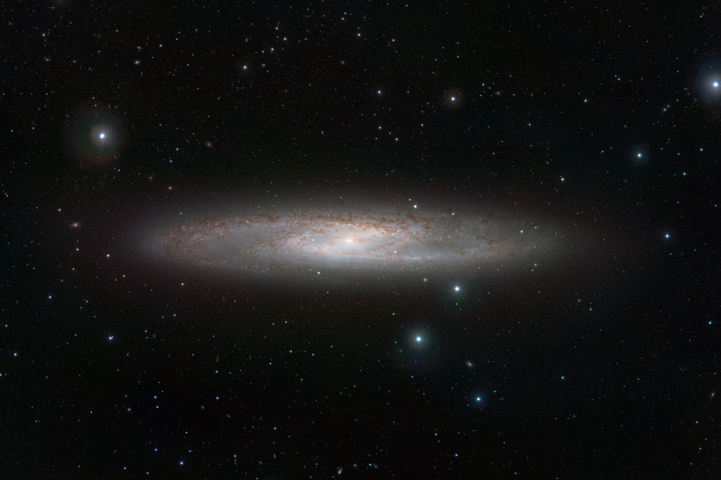

Slide 34
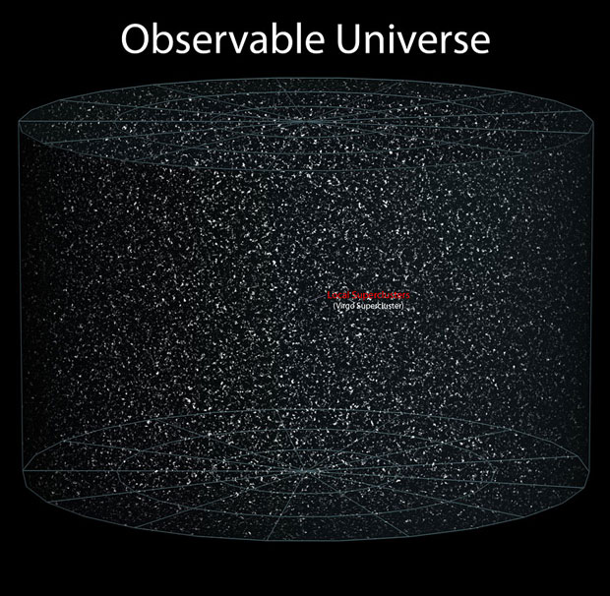
?

Slide 35
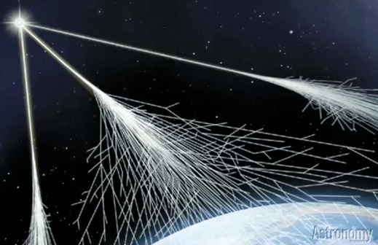
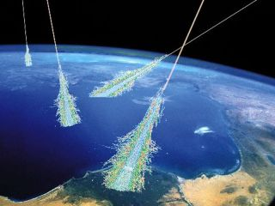
Particles

Slide 36
Particles
IGM: 1 particle / meter^3
Galaxy: 1 particle / cc
GMC: 1000 / cc
GMC Cores: 10^6 / cc

Slide 37

“Quantum Fluctuations” – Chromodynamics or something

Slide 38

Zero-Energy Universe
Postulated in 1973
Equal amount of positive-energy matter and negative-energy space/gravity
Whole universe might be a “quantum fluctuation”
Source of the big bang
Could explain “flatness” of universe”
Idea: Spacetime contains energy, and is a part of “empty space”

Slide 39


SPACE IS AN “OBJECT”!

Slide 40


Slide 41


Slide 42
Space is Full
>Space is an object, filled with:
(Magnetic) Fields
Photons
Cosmic Rays
QCD Nonsense
Hydrogen (“Stuff”)
>For Matter: When you zoom out,
you also have to increase the size of your handful.
>There is way more stuff in space than on Earth.

Slide 43
Extra Stuff – Graduate Admissions
Don’t explain the details of your research – they don’t really care
Do include a few extra-curriculars. It counts for a lot!
A grit story is great to have too.
Letters of Rec are kind of just a box to check
Make sure to say
Why you want to go to grad school at all
Why you want to go to this particular grad school

